Slide 1
Solar Energy
The sun is a sphere of intensely hot gaseous matter with a diameter of 1.39 × 10⁹ m and is, on the average, 1.5 × 10¹¹ m from the earth.
The sun has an effective blackbody temperature of 5777 K.

Slide 2
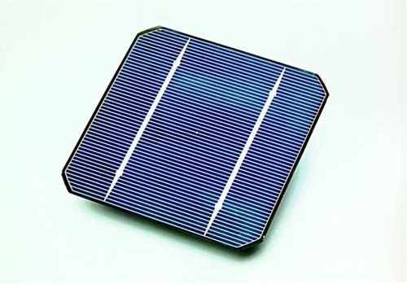
Solar Energy
Electricity from solar energy
Tabs
Grid lines

Slide 3
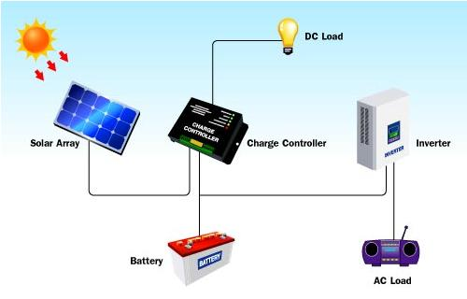
Solar Energy
Electricity from solar energy

Slide 4
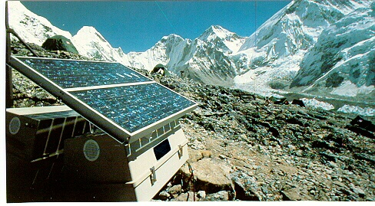
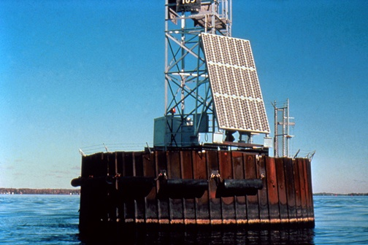
Solar Energy
Electricity from solar energy

Slide 5
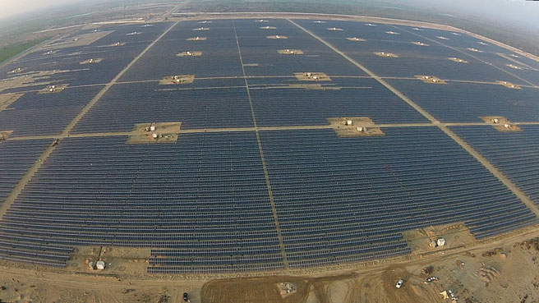
Solar Energy
Quaid-e-Azam Solar Park
“The plant is giving an average yield of 169 gigawatt hour against the annual target of 153GW hour to meet 153 million units production requirement,”
https://www.qasolar.com/

Slide 6
Solar Energy
Quaid-e-Azam Solar Park
• Average daily irradiation amounts to 5-7 kWh/m² with 3000 hours of sunshine available annually.
• Government of Punjab has allocated 6,500 acres (26 km²) of land in Southern Punjab for “Quaid-e-Azam Solar Park”
• The solar park has a total potential of more than 1,000 MW. The Government of Punjab is launching its flagship project of 100 MW Solar PV Power to set the ball rolling.
• Solar power projects are exempted from custom duty, sales tax, income tax, turnover tax and withholding tax on imports

Slide 7
Solar Energy
Quaid-e-Azam Solar Park
The plant is giving an average yield of 169 gigawatt hour against the annual target of 153GW hour to meet 153 million units production requirement.
Using above data can we estimate length of average solar day?

Slide 8
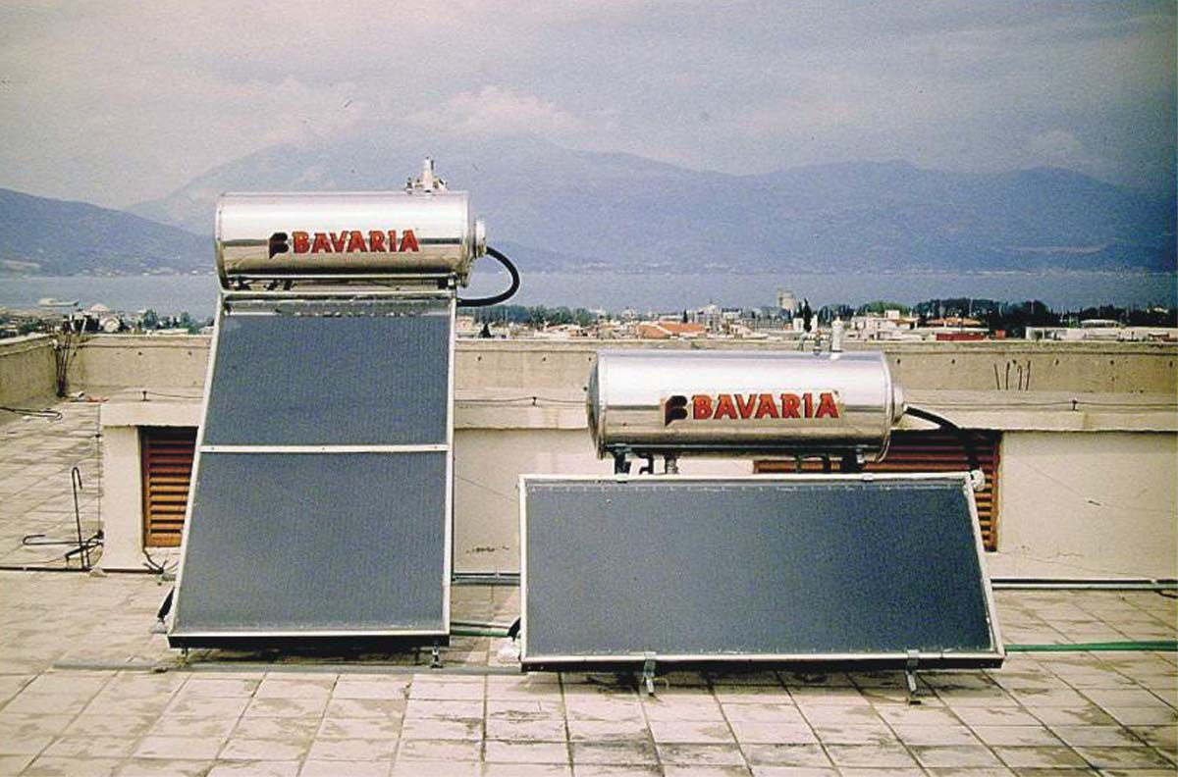
Solar Energy
Solar water heating

Slide 9
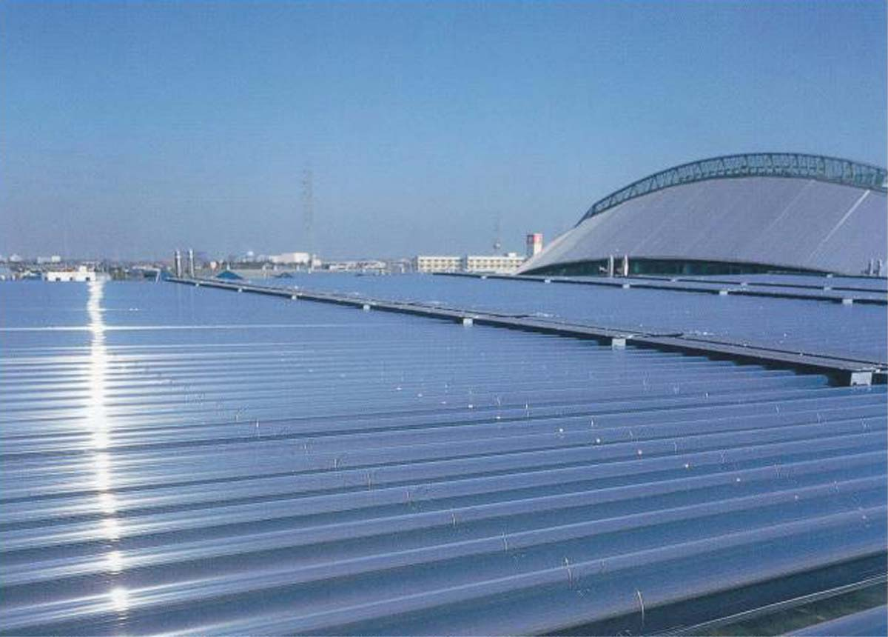
Solar Energy
Evacuated tube collector on a roof in Germany

Slide 10
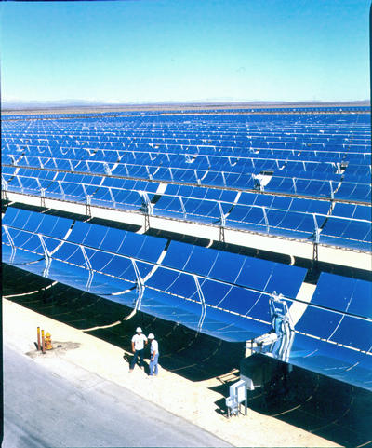
Solar Energy
Solar thermal system for power generation

Slide 11
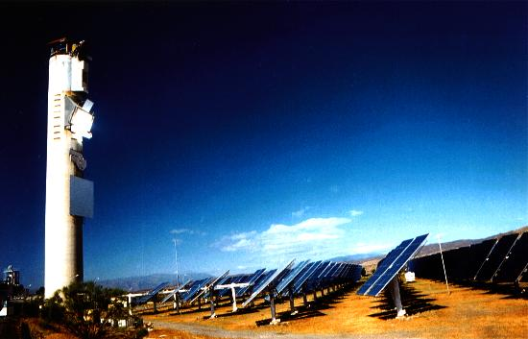
Solar Energy
Power tower at CESA in Spain

Slide 12
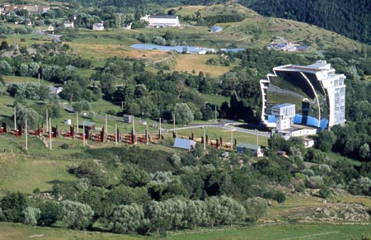
Solar Energy
Solar furnace in France
12

Slide 13
Solar Energy
Solar furnace in France
Incident solar radiation is converged towards a circular target on top of a central tower; this target was only 40 cm in diameter. That is equivalent to concentrate the energy of "10,000 suns.“
Temperatures above 3,500 °C (6,330 °F) can be obtained in a few seconds.
The energy is "free", and non-polluting.
This furnace provides rapid temperature changes and therefore allow studying the effect of thermal shocks;

Slide 14
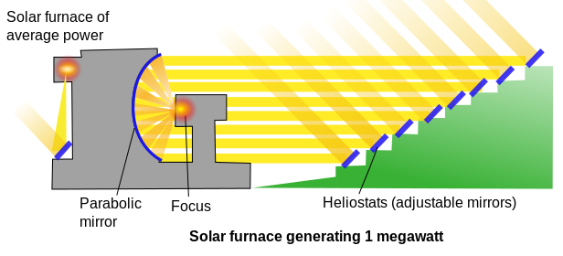
Solar Energy

Slide 15
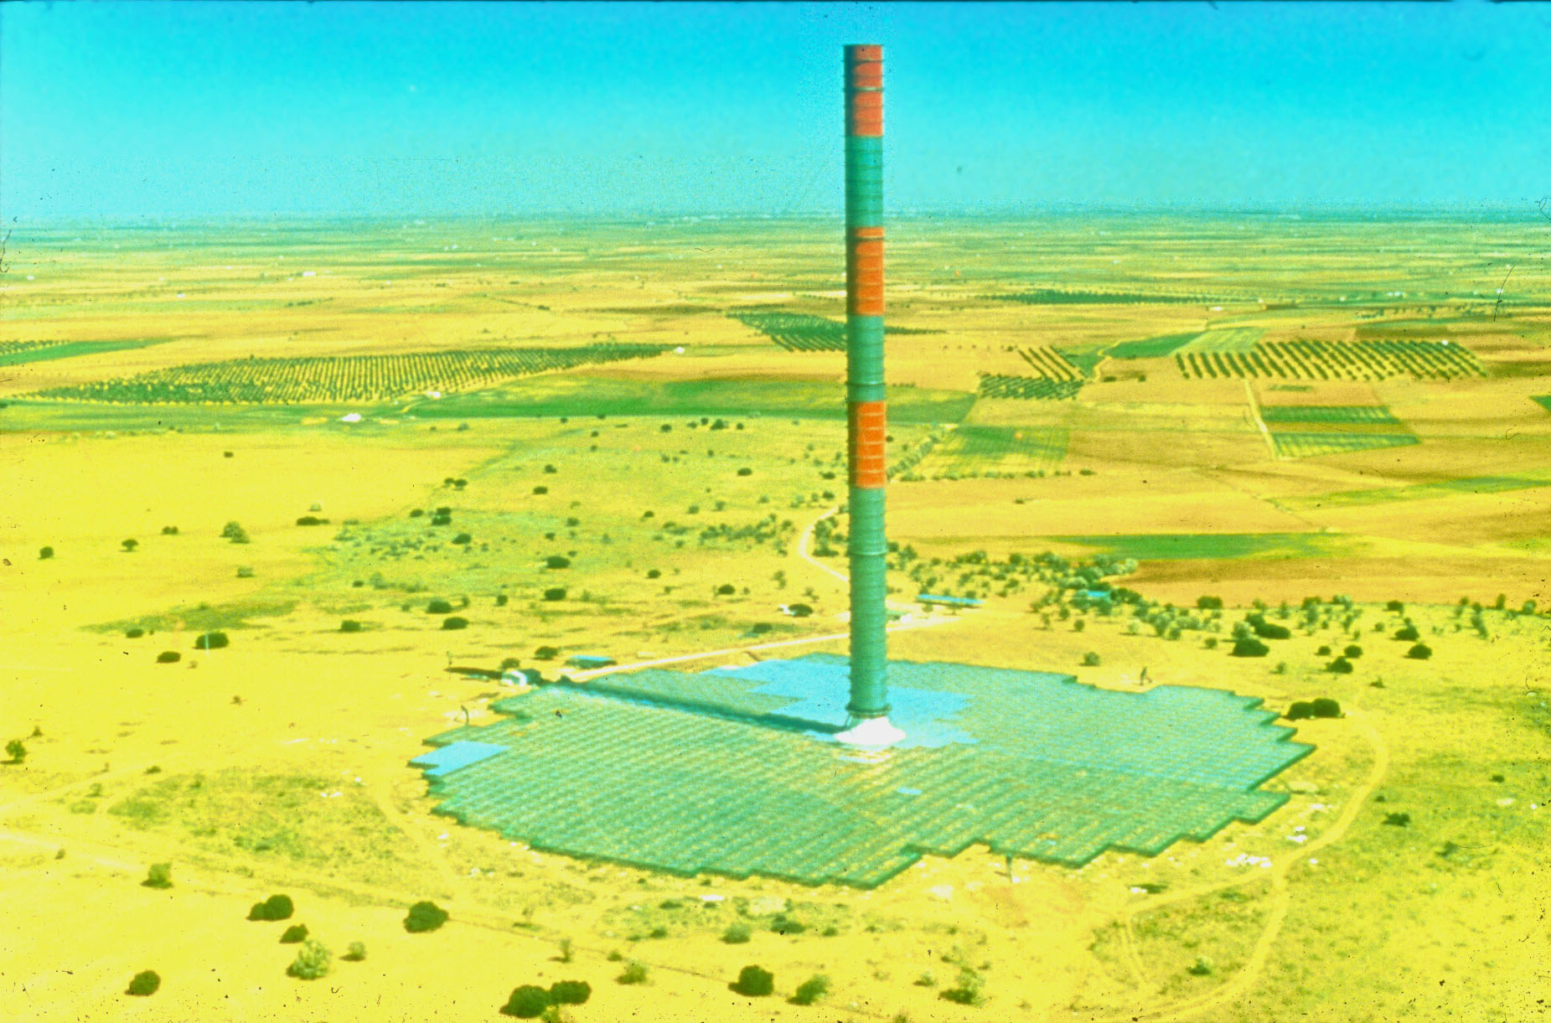
Solar Energy
Solar Chimney in Spain

Slide 16
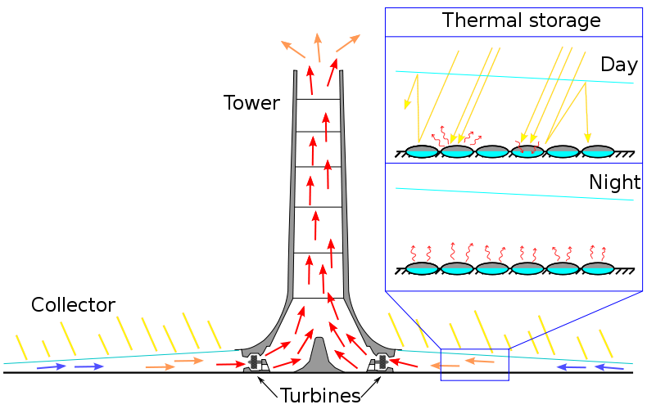
Solar Energy
Solar Chimney in Spain

Slide 17
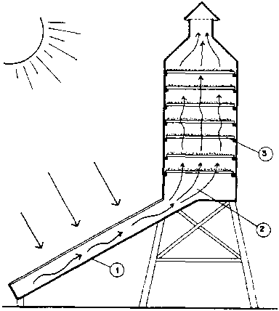
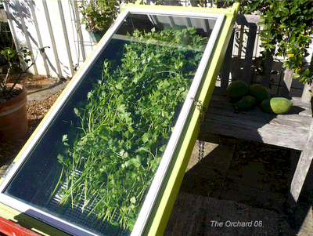
Solar Energy
Drying agricultural products

Slide 18
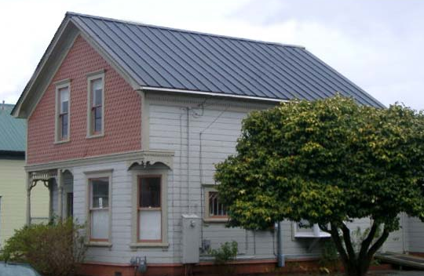
Solar Energy
Solar roof in the USA

Slide 19
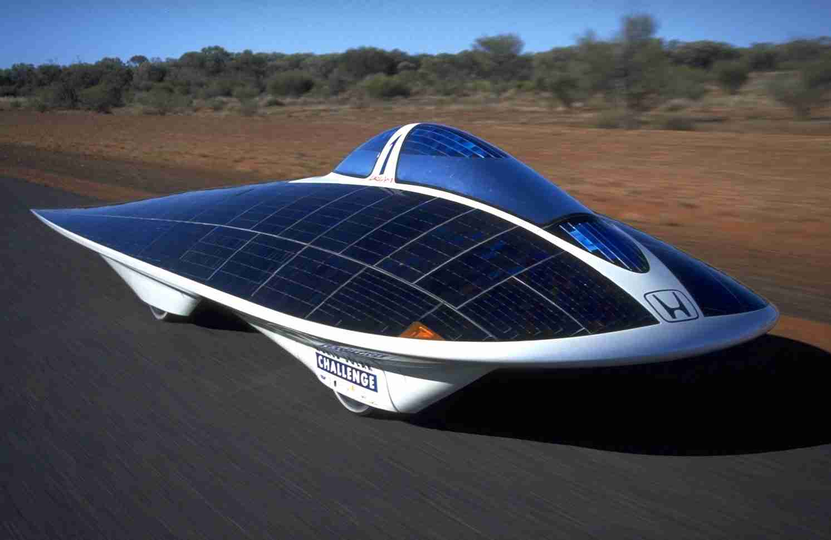
Solar Energy
Solar challenge

Slide 20
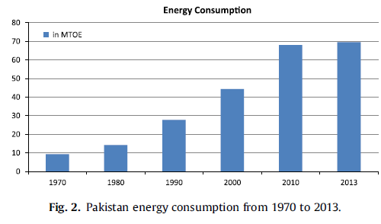
Solar Energy
Energy consumption in Pakistan

Slide 21
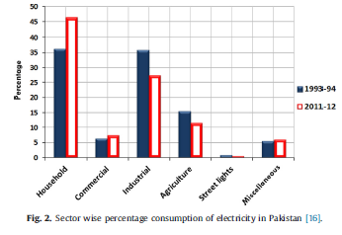
Solar Energy
Energy consumption in Pakistan

Slide 22
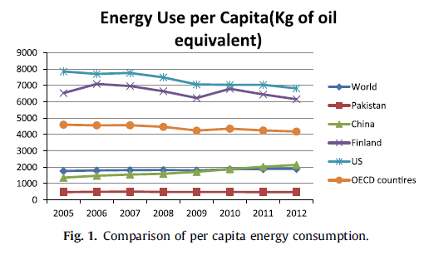
Solar Energy
Energy consumption-Pakistan vs Rest of world

Slide 23
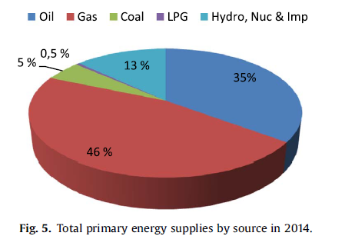
Solar Energy
Energy demand and primary energy sources

Slide 24
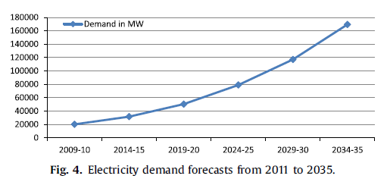
Solar Energy
Energy demand and primary energy sources

Slide 25
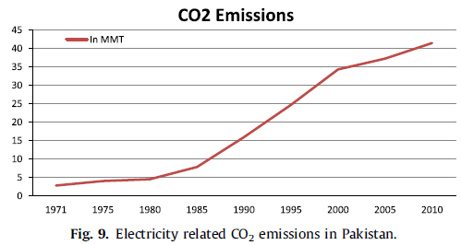
Solar Energy
Carbon emissions and cost of electricity

Slide 26
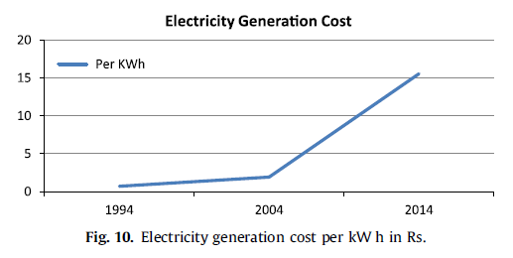
Solar Energy
Carbon emissions and cost of electricity

Slide 27
Solar Energy
According to Kafaitullah, the energy sector contributes over 80% of all the CO2 emissions in Pakistan. In 2010,Pakistan produced 164 million metric tons (MMT) of carbon emissions, out of which 42 MMT came from electricity, approximately 25% of all the emissions.

Slide 28
Solar Energy
On average, the country receives15.5*10¹⁴ kWh of solar radiations per year with most of the areas having 8–10 h of sunlight a day.
The assessed potential is around1600 GW annually, more than 40times the existing power generation capacity.
According to Chaudhry et al., the Baluchistan province is one of the best in terms of solar irradiation potential, with 8.5 h of average sunlight per day and 20MJ/m² of solar insolation.

